Slide 1

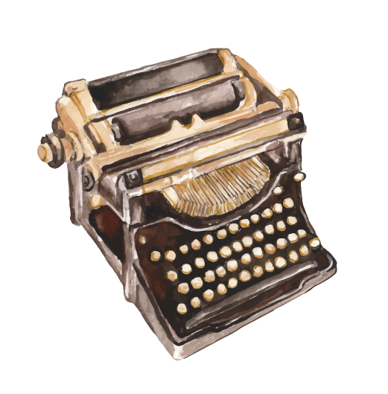
Old inventions vs.
New inventions
Nika Šimunović, 2.c

Slide 2
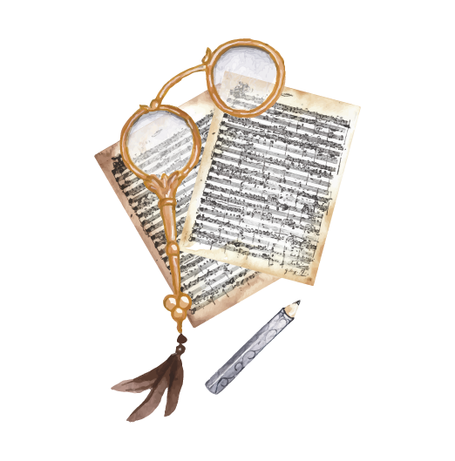
Introduction
It is common sense that time passes by, and that nothing is permanent. People make new discoveries, and those new discoveries most likely replace the old ones.
New discoveries don’t have to be better than old discoveries, they could be more modern, and they have that weird feeling that makes them seem better because they aren’t as used as the old inventions.
In this presentation I will introduce you to old inventions that had been replaced by newer ones, and I will show you some major differences between them. Enjoy!

Slide 3
Connections between businesses and old technology
When we talk about marketing, there exists one catch around old inventions. When we see some object that has historical values, we could be forced into buying that object because of an emotion called nostalgia. This is one of the main ways someone could trick a customer into buying an old product.

Slide 4
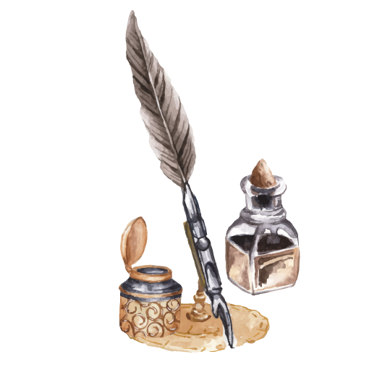
Categories
02
01
Inventions
Clothes
03
Music
Inventions which changed history.
Clothes which were worn, and which are still being worn, and the differences in quality.
Vintage music that is listened to, still to this day.

Slide 5
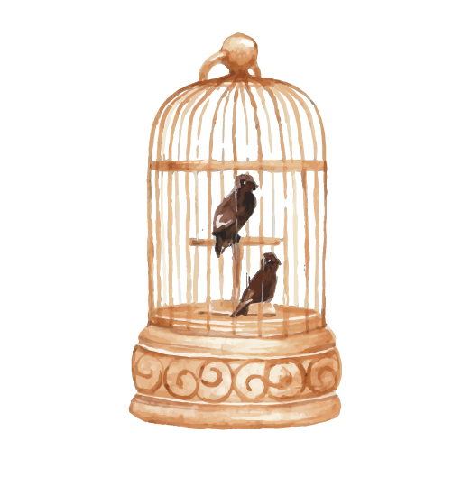

01
Clothes

Slide 6
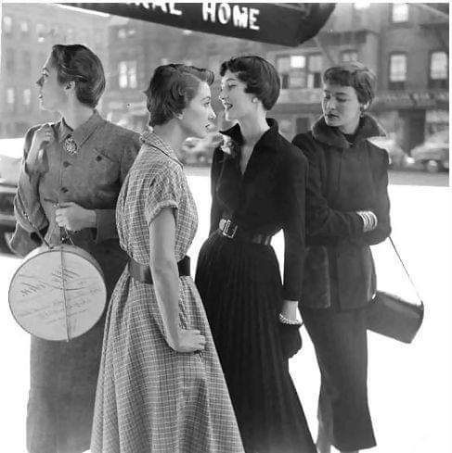
We know that in history, many different periods of fashion have existed in the years. Every period is marked by some piece of clothing. When we attempt to find differences between today’s fashion and histories fashion, we can see some trends coming back to life.
New trends can also appear, but today, those trends are very bizarre. For example, you can find some crocks which you can purchase for 10$, which can cost up to 1000$ in some branded stores. Today’s clothing material is much worse quality then the material used in the past.

Slide 7
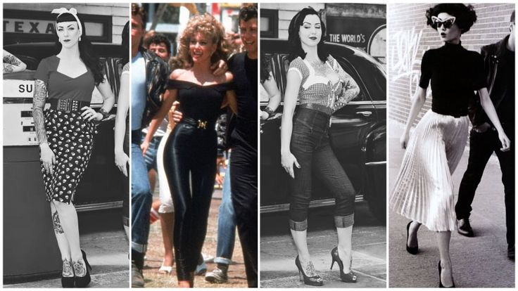
50ies style
War clothes from the 40ies were changed to elegant female clothes in the 50ies.
The main characteristic from this period was the hourglass look. This period also popularized the casual style. Narrow-waisted suits were very popular, along with dresses.
The cloth was made of silk and cotton. Gloves were also worn because they would look good when they were paired with hats and pearl jewelry.
This clothing style is my favorite, and I would be very happy if it returned.

Slide 8
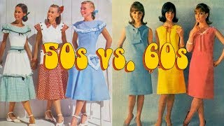
60ies style
Fashion was marked by contrast combinations of color and textures. Dresses had an A-silhouette. Pastel colors were mostly used for suits and dresses.
In the clothing industry, people were starting to use different materials like plastic and such. Round glasses were very popular in this period as well.
People would also cover their lips with natural shade and shine.

Slide 9
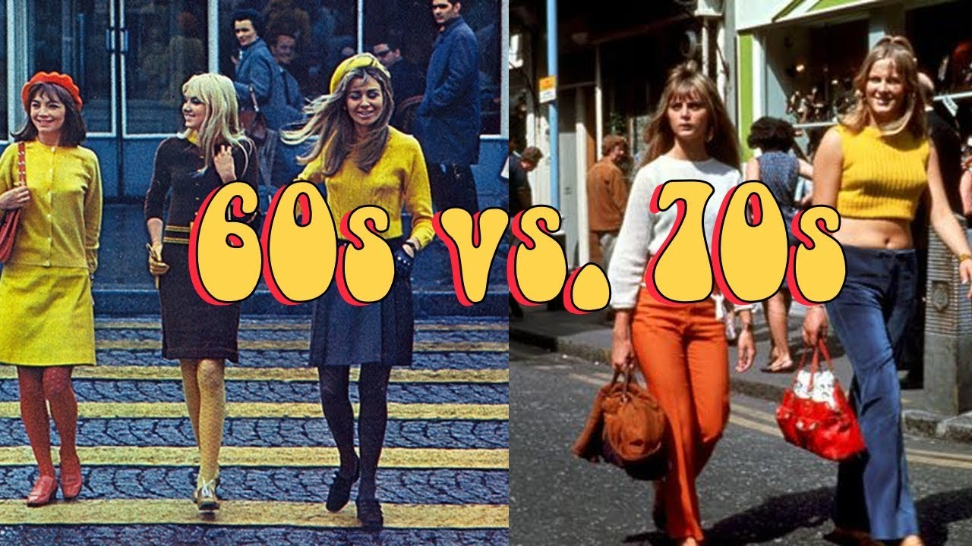
70ies style
In the 70s, clothes with wild colors are still the norm, people wore pants in the shape of a bell, sweaters of bright colors, batch jackets, dresses, and similar clothing pieces.
Samples are mostly made of dots, flowers, and similar decorations. Jeans were very expensive, and they weren’t that common just because of their hefty price.
High heels were also in high fashion, heels could reach up to 10cm. The most common hairstyle was Gayroche.

Slide 10
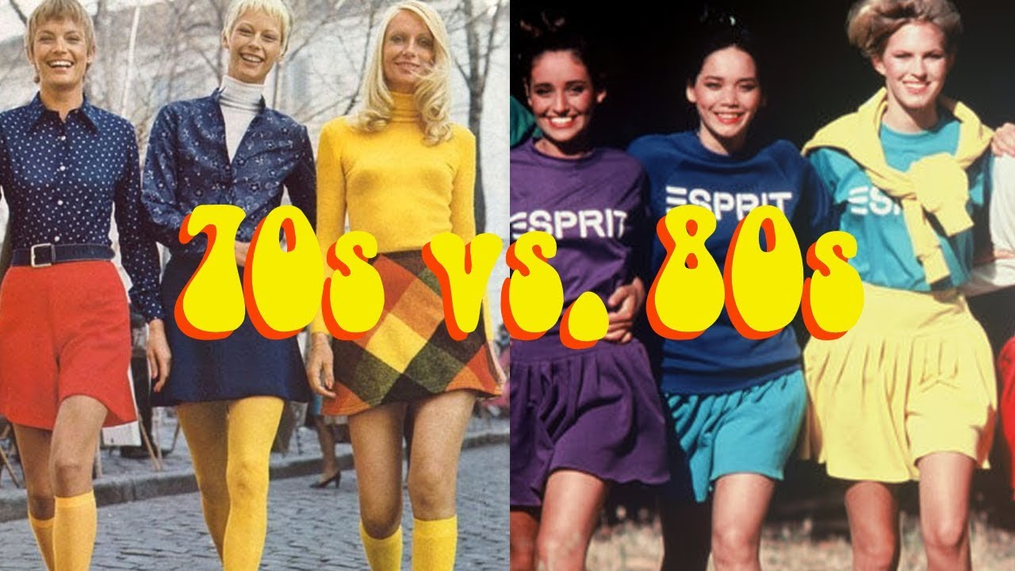
80ies style
In the 80s, people started wearing shirts with batwing sleeves. The clothing hadn’t changed to much, the colors remained the same. People had started wearing belts.
The princess Diana style came to life, a blouse with a tie. Tight jeans started to become popular too.
The younger generation preferred the sport style. Makeup was mostly colored pink, and the hairstyles were quite messy.

Slide 11
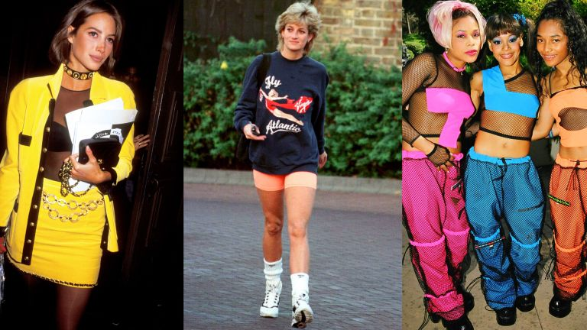
90ies style
In the 90s, there wasn’t one style that was overused more than the others.
The colors became more neutral than in the previous decades. People wore ripped jeans with vests. Sports clothes were worn more often because people would adore slim figures.
The most common materials were cotton, fake fur and stretchy materials for jeans.

Slide 12
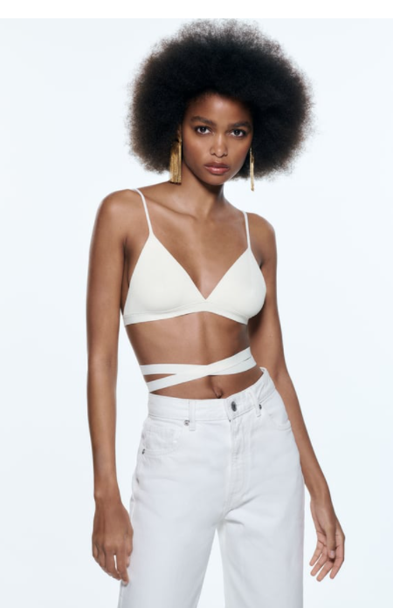
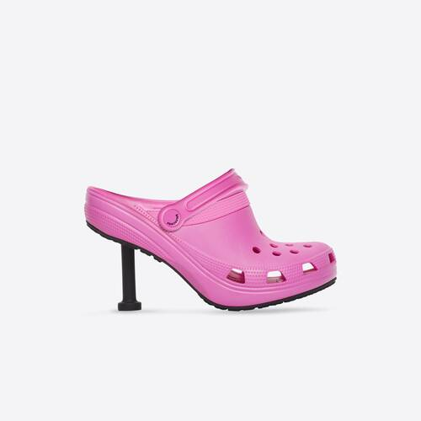
In my opinion, today’s style is based on exposing body parts, the women skin you can see, the better. Girls wear clothes which show more skin than they cover, and that clothing style is getting accepted more and more as time goes by.
I won’t be surprised if in the future we all start walking around on the street naked. The current clothing style has many bizarre clothing items too, like crooks with heels, a dress which is black on one side and red on the other.
Materials aren’t as high quality as they once were, when we buy something new, it doesn’t have the same feeling as it had before. Also trends come and go very quickly, and some clothes can become useless in a matter of months.

Slide 13
02
Inventions

Slide 14
Inventions are a good solution to our problems. People are always trying to invent new things to make their lives just a little bit easier.
For example, if Nikola Tesla was never born, we probably wouldn’t have electricity, which is helping us in so many ways. If vaccines were never invented, a large amount of people would die from diseases and pandemics would be much more common.
In the next couple of slides, you will find out some stuff about innovations.

Slide 15
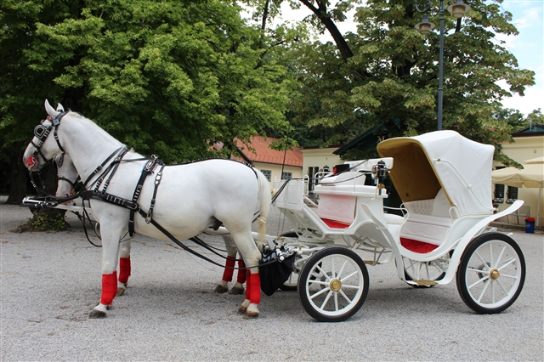
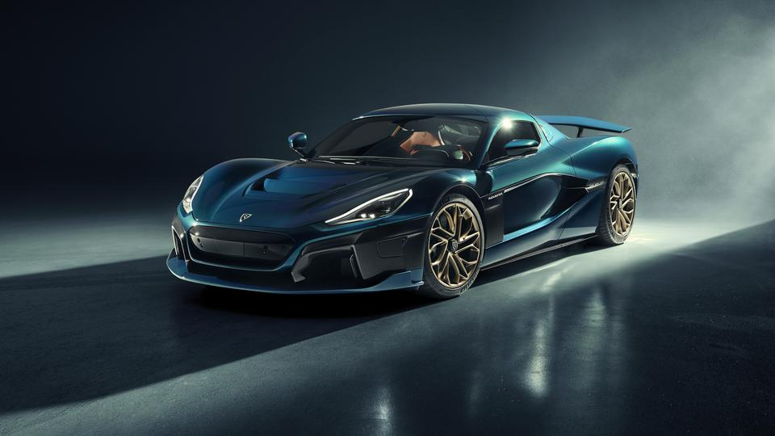
In early history, people were buying things with land. For transport, boats were necessary to travel through the ocean, and on land, horses were the most common transportation method.
Today, horses are completely replaced by cars. Cars are much faster for transporting something we buy or to travel to a vacation.
Carriages are now a part of history, and sometimes for tradition, newly married couples would ride around in carriages for their wedding celebrations.

Slide 16
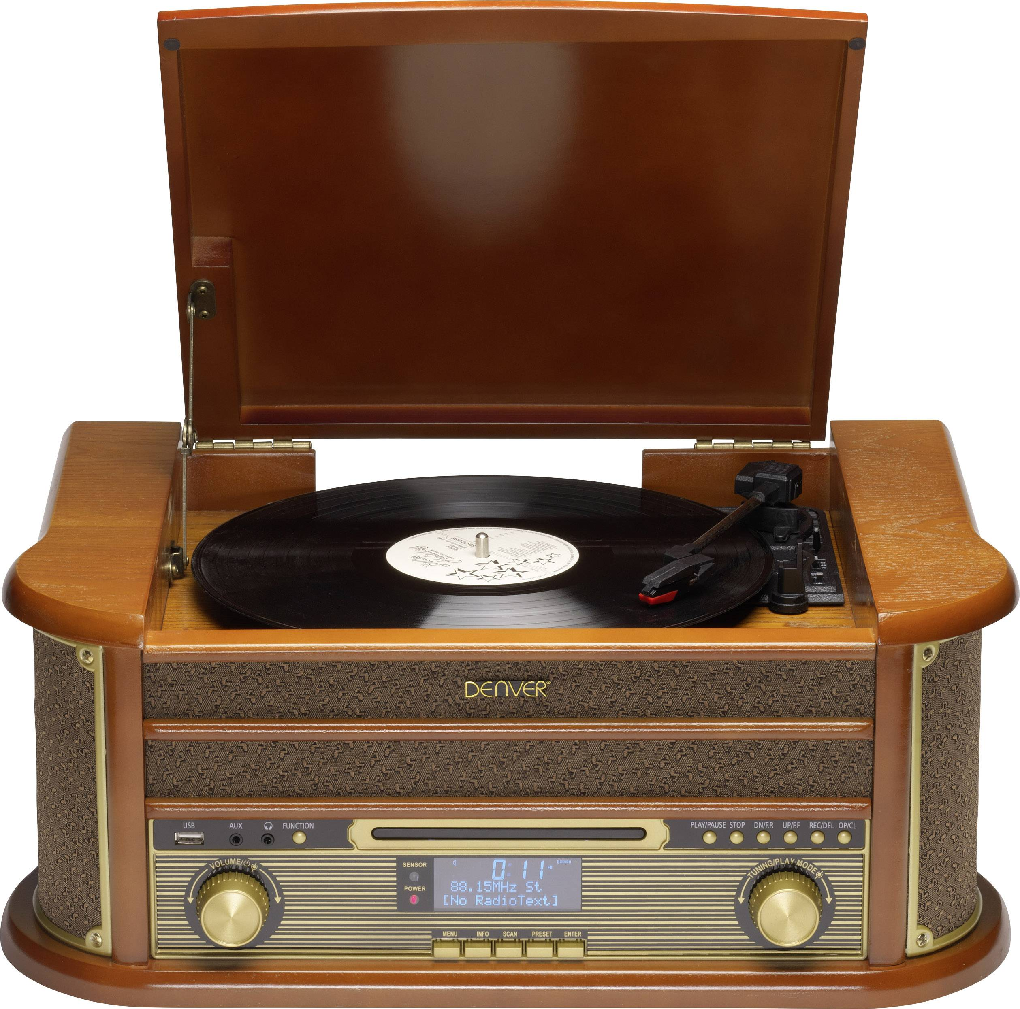
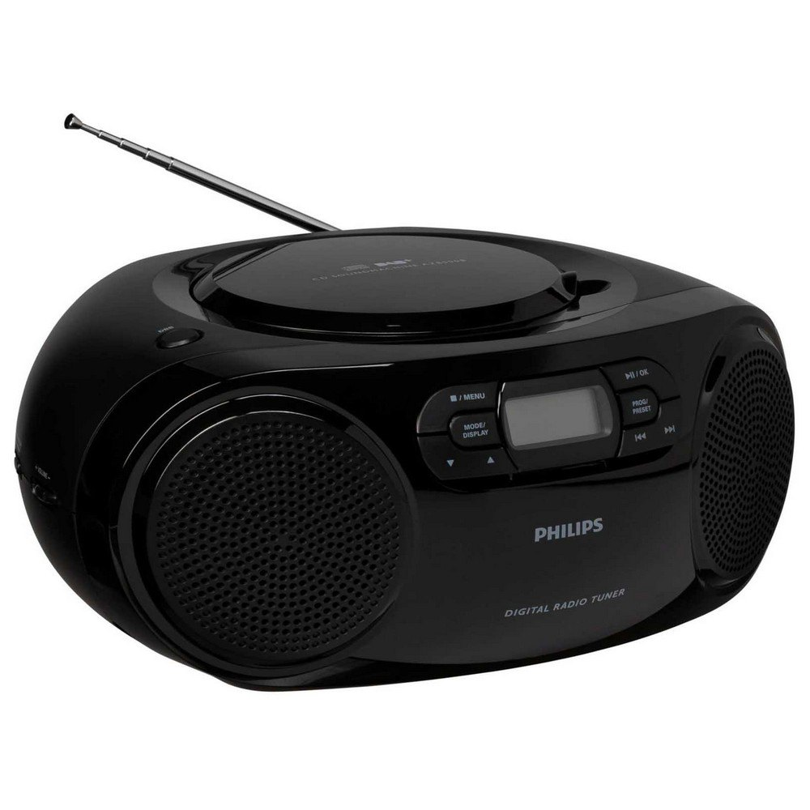
A gramophone was made in 1887. It was used for reproduction of music that was stored in records. Records were on sale in stores which would only sell them. Today, gramophones are completely replaced by radios, though sadly, a radio doesn’t have the same sound as a gramophone.
Radios can sometimes have interferences which would worsen the sound. Although radios replaced gramophones, radios are hardly used today, they are also being replaced by other technologies. People can listen to music using their phones and it is easier than ever before.

Slide 17
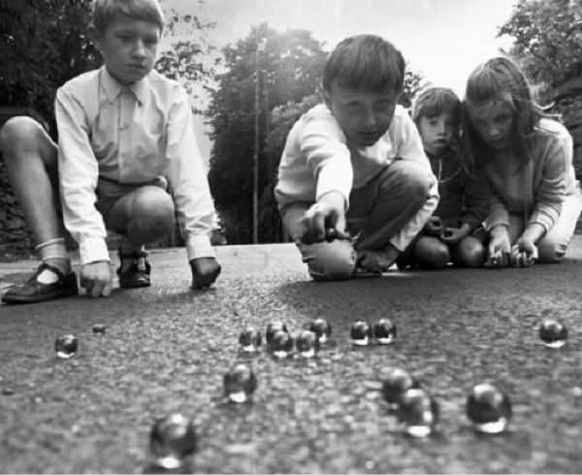
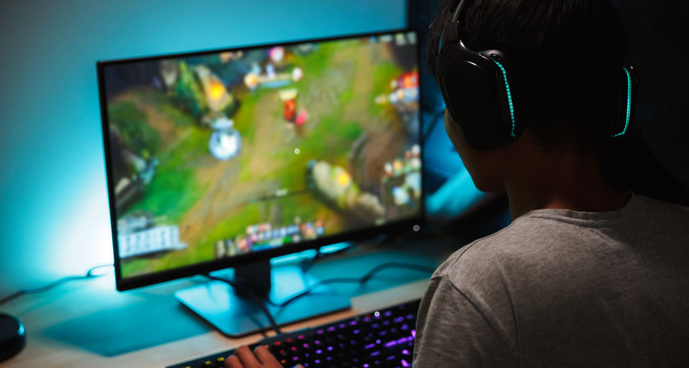
Before the beginning of the video game era, children would play outside a lot, and they would spend a lot of time together. Children before didn’t have virtual games like they do now. We can say that kids enjoyed playing together 50 years ago more than today’s kids who play videogames all day.
Kids don’t spend time together outside, they don’t talk to each other as much in the outside world, and they mostly communicate online. Videogames do get boring pretty quickly nowadays, the reason for that is when we grow up, we no longer get satisfied by videogames as much as we used to, so we spend less time playing them.

Slide 18
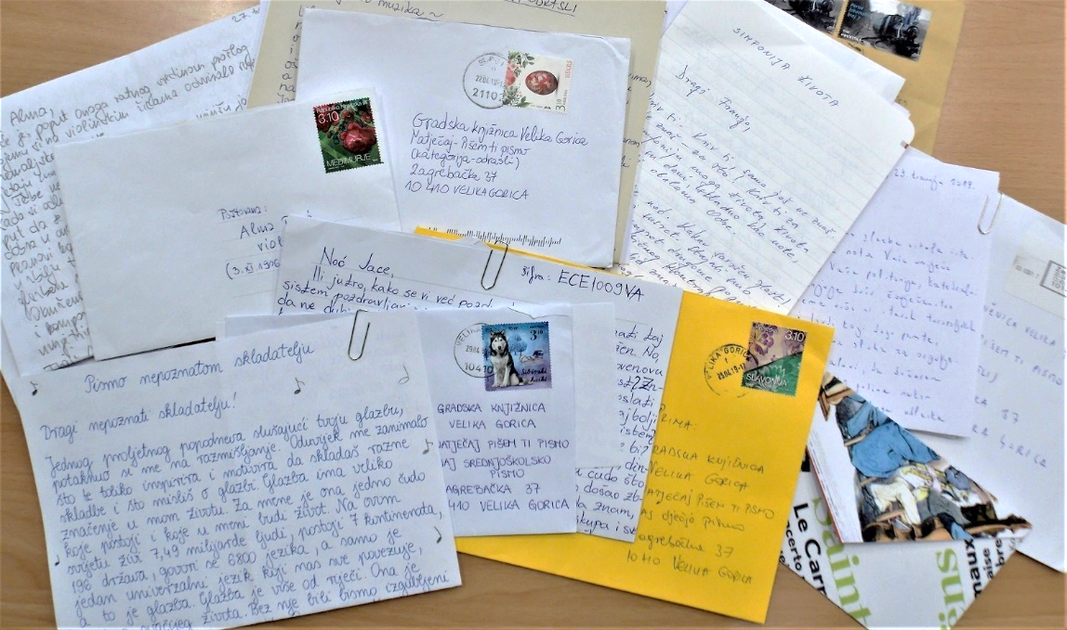

Earlier, when social media didn’t exist, people would use letters to communicate to each other. Letters were usually decorated with many decorations and stamps. People also wrote their letters in a correct grammatical way.
Today, people don’t go by these rules. Because of that, it isn’t too uncommon to not understand someone else’s text because they didn’t put a comma in their message. People also use their phones to communicate and don’t use paper as much. This can lead to people forgetting how to write certain letters and people would worsen their handwriting.
Today, letters are a thing of the past, they are never used, although some people do collect stamps.

Slide 19
03
Music

Slide 20
Popular music
In the past, music was listened to on gramophones. People had records with music on them which they would listen to for hours. The most common genres of music were rock and pop. Old music was better than today’s music and people enjoyed the music more than we do today. Songs were much more original than they are today and that is one of the reasons that today’s music won’t be better than music in the past

Slide 21
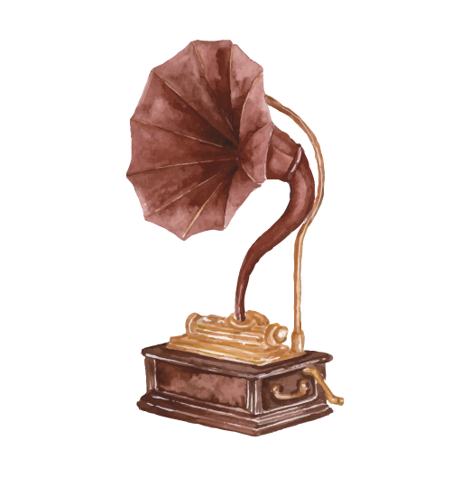
Artists and bands that were listened to:
Guns n’ roses
Abba
Queen
Elvis Presley
Nirvana
Michael Jacson
AC/DC
Tina Turner
The Sex Pistols
Pink Floyd

Slide 22
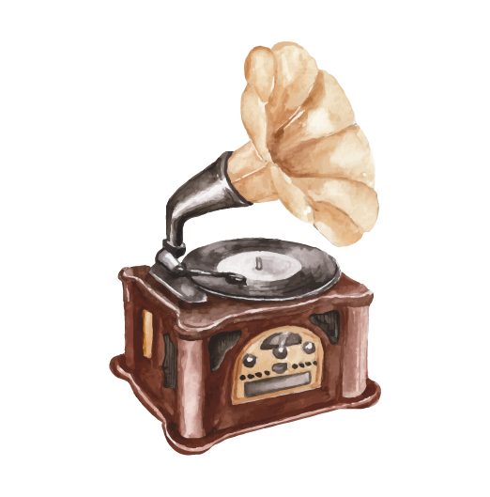
Artists today
Today, people listen to all kinds of music. In Croatia, people mostly listen to Croatian trash music, patriotic songs or they listen to an artist like Oliver Dragojević. Songs from older artists are of higher quality than newer songs. Pretty much all modern music is either not creative or they have irrelevant text. Those songs are listened to for a short period of time and are most likely forgotten.
In the world, people mostly listen to artists like Adele, Rihanna, Beyonce, Eminem, and others. Today you can find a large variety of music and many different genres.

Slide 23
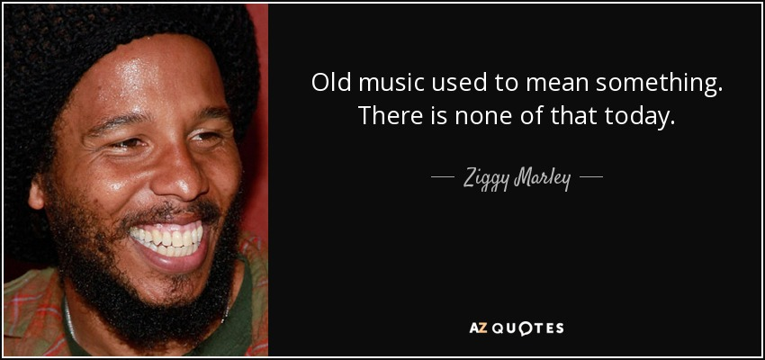
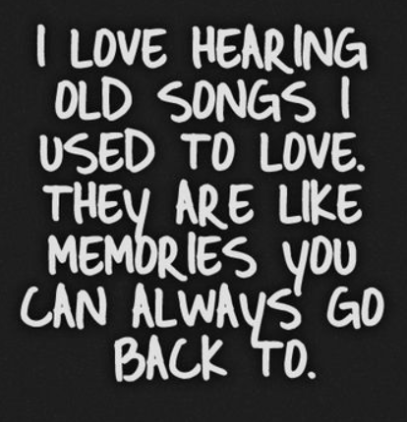

Slide 24

Thank you for the attention!
“The past is the beginning of the beginning and all that is and has been is but the twilight of the dawn.”
H. G. Wells

